Slide 1


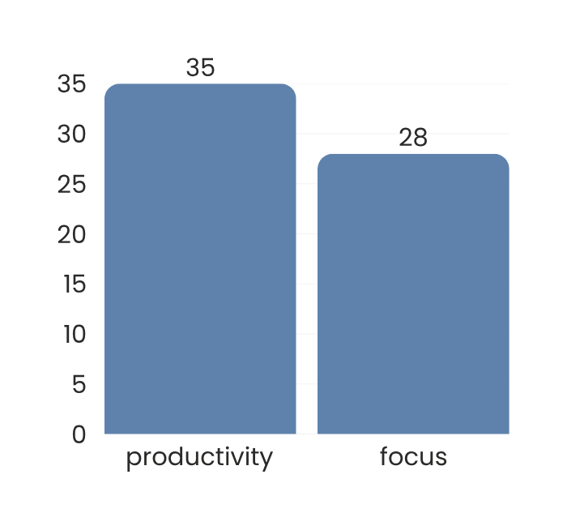


Yael Amari | Rimberio University
RESEARCH INFOGRAPHIC POSTER
Understanding Urban Lifestyle Patterns
Research Overview
Methodology
This research examines how daily lifestyle choices affect productivity, health, and overall well being.
Data collection: Online survey
Sample: 250 respondents
Duration: 3 months
Age range: 18–35 years
Objective
Key Insights
To analyze common lifestyle patterns and identify behaviors that support healthier, more balanced living outcomes.
Focus Level
Productivity
Data Highlight
Screen Balance
Well being
Conclusion
Small lifestyle changes can measurably improve productivity and quality of life.

